Slide 1
Instructor: Wei Shih-Han
Introduction to Image Processing and Computer Vision with OpenCV

Slide 2
Outline
OpenCV Installation
Basic Image Processing and Computer Vision
Introduction
Convolution
Edge Detection
Hough Transform
Feature Extraction and Matching
Homework
Homework 1
Homework 2

Slide 3
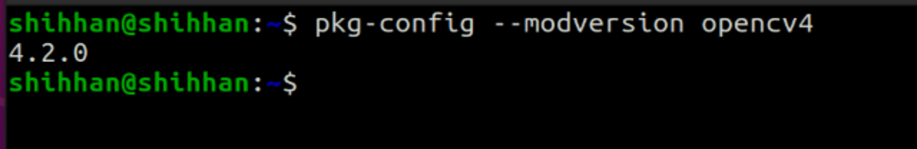
OpenCV Installation
You already installed it in last week's class
Type pkg-config --modversion opencv4 (to check the OpenCV version)

Slide 4
OpenCV Installation
Compile & Run the Program
C++
Compile
g++ your_program.cpp -o file_name `pkg-config --cflags --libs opencv4`
Run
./file_name
Python
python3 file_name.py

Slide 5
Basic Image Processing and Computer Vision
What’s the difference between image processing and computer vision?
Image processing refers to the operations performed on images to enhance their visual quality or to extract useful information.
Computer vision is the technology that enables computers to “understand” or “interpret” the world from images or videos.

Slide 6
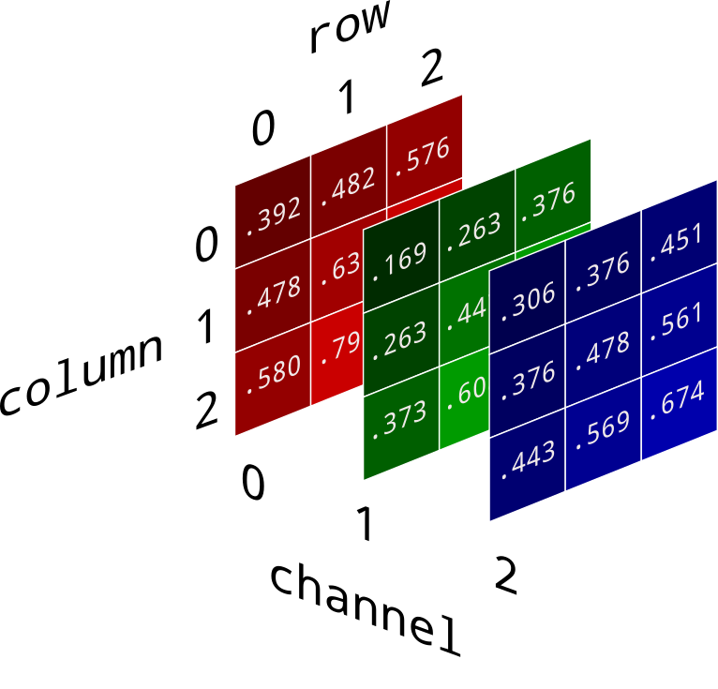
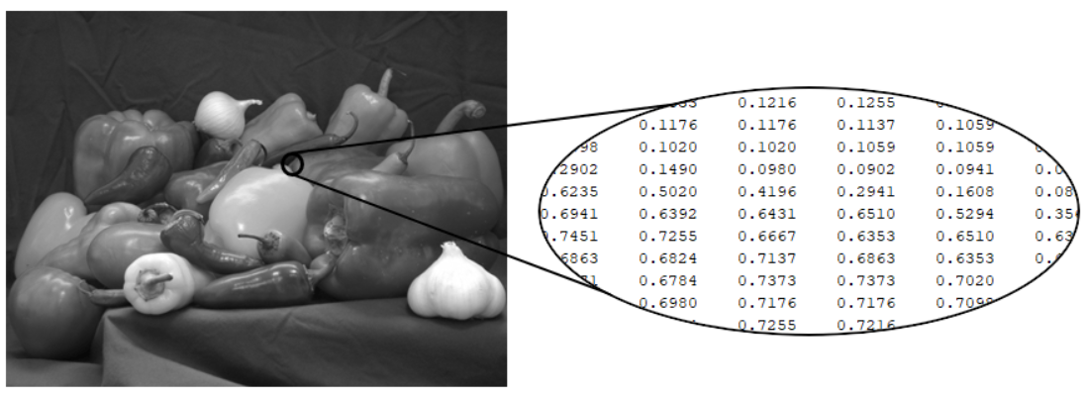
Basic Image Processing and Computer Vision
What is the Image?
Grays Scale Image
Color Image

Slide 7
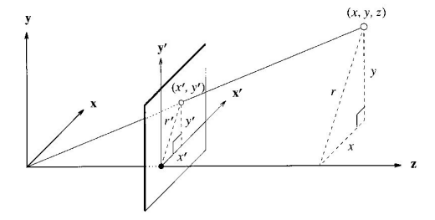
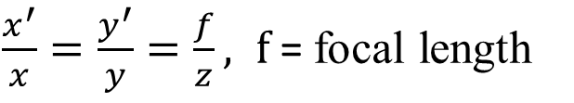
Basic Image Processing and Computer Vision
Perspective Projection
$\frac{x^{′}}{x}=\frac{y^{′}}{y}=\frac{f}{z}, f$ = focal length
f

Slide 8

Basic Image Processing and Computer Vision
Basic OpenCV Tutorial
cv2.imread(‘file_name’, flag)
cv2.imshow(‘window_name’, image)
cv2.imwrite(‘file_name’, image, params)

Slide 9


Basic Image Processing and Computer Vision
Convolution Operation

Slide 10

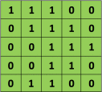

Basic Image Processing and Computer Vision
Convolution Operation
5 x 5 image
3 x 3 kernel

Slide 11
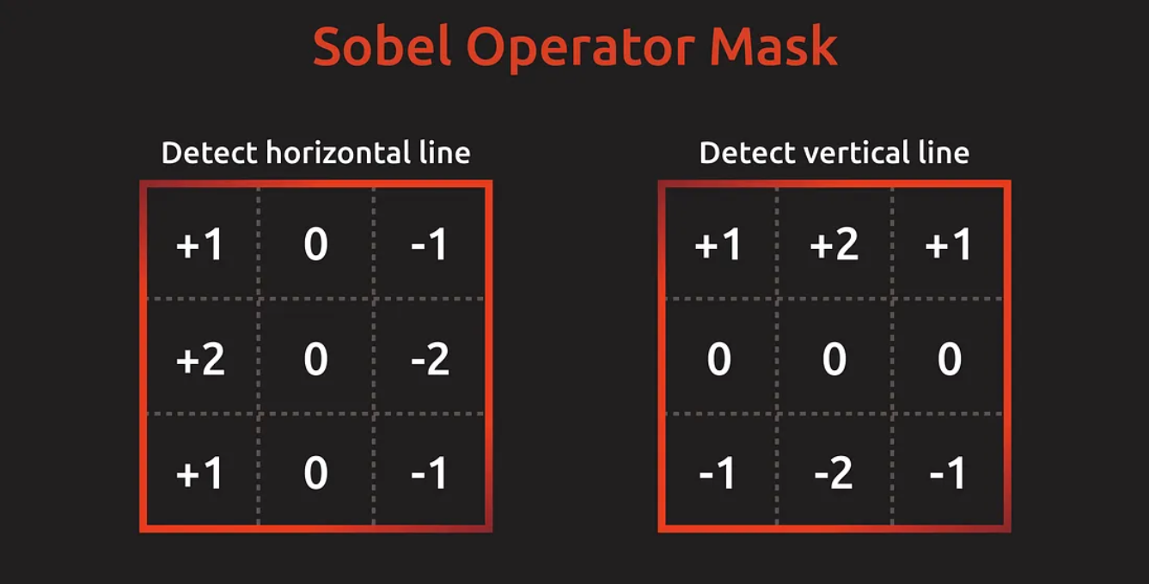
Basic Image Processing and Computer Vision
Edge Detection
Sobel Operator

Slide 12
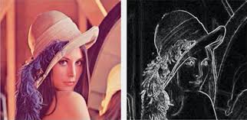
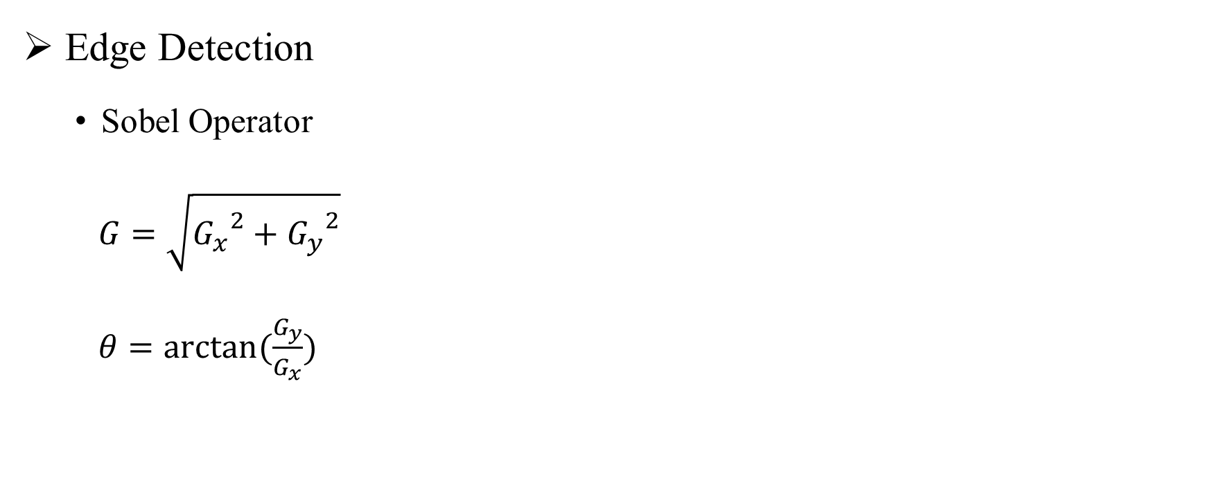
Basic Image Processing and Computer Vision
Edge Detection
Sobel Operator
$G=\sqrt{{G_{x}}^{2}+{G_{y}}^{2}}$
$θ=\arctan{(\frac{G_{y}}{G_{x}})}$

Slide 13
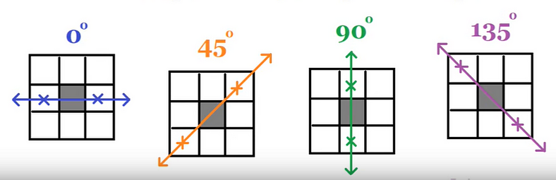
Basic Image Processing and Computer Vision
Edge Detection
Canny Edge Detection
Noise reduction
Gradient calculation
Non-maximum suppression
Double threshold
Edge tracking by hysteresis

Slide 14
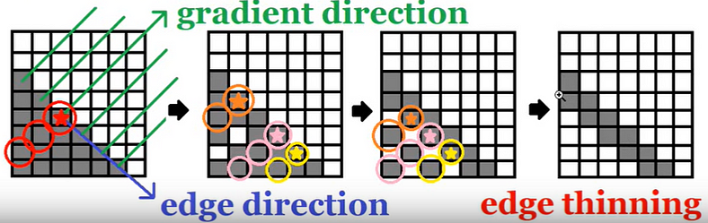
Basic Image Processing and Computer Vision
Edge Detection
Canny Edge Detection

Slide 15
Basic Image Processing and Computer Vision
Edge Detection
Canny Edge Detection
Double threshold: Identify strong, weak, and non-edges based on gradient magnitude.
Edge tracking by hysteresis: Finalize the edge detection by suppressing weak edges that are not connected to strong edges.

Slide 16
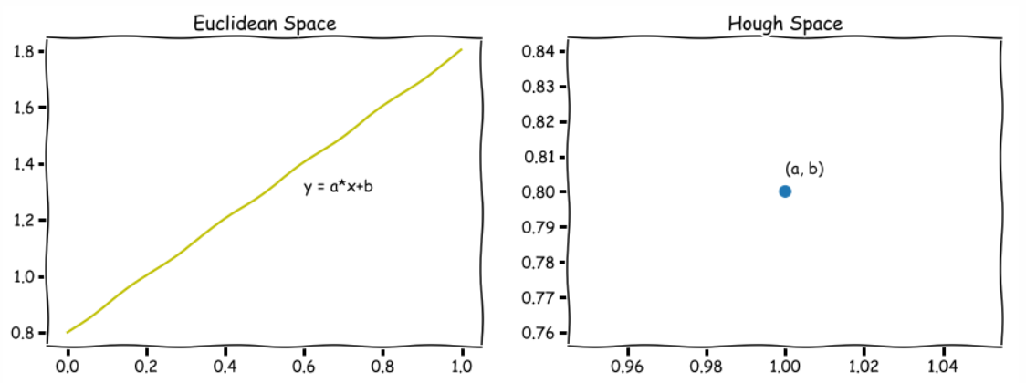
Basic Image Processing and Computer Vision
Hough Transform

Slide 17
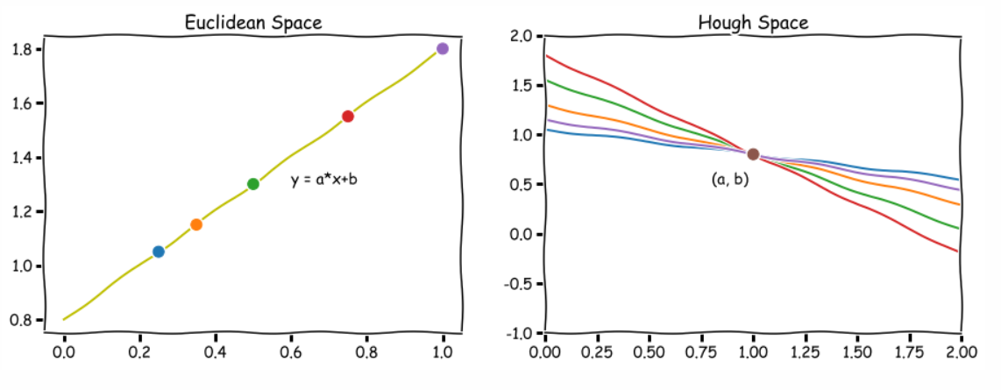
Basic Image Processing and Computer Vision
Hough Transform

Slide 18
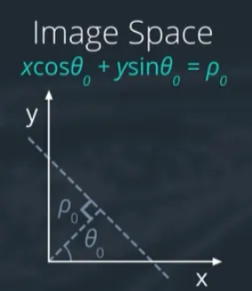
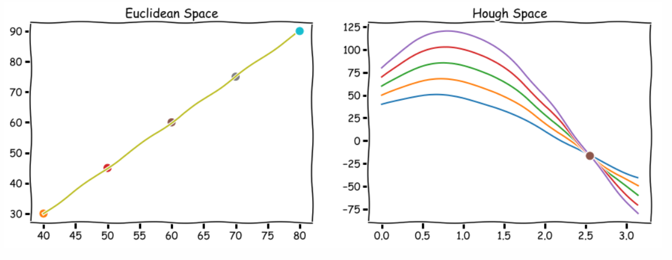
Basic Image Processing and Computer Vision
Hough Transform

Slide 19
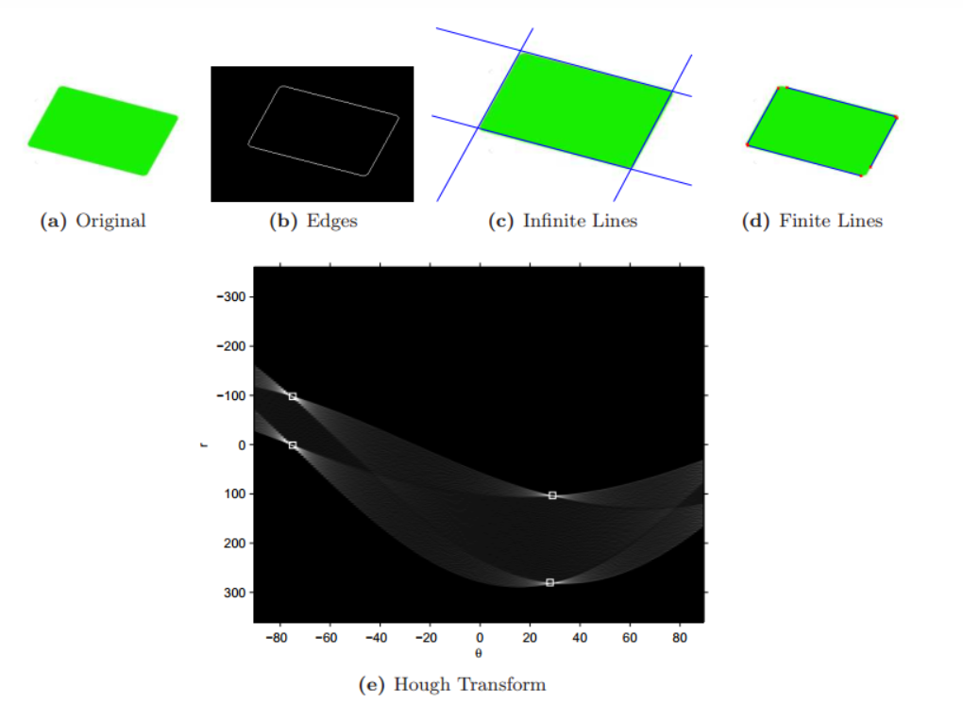
Basic Image Processing and Computer Vision
Hough Transform

Slide 20
Basic Image Processing and Computer Vision
Feature Extraction and Matching
Feature extraction and matching are crucial steps in computer vision, used to extract meaningful information from images and establish correspondences between different images or different parts of the same image.
Features can include corners, edges, blobs, and other unique elements within an image that have distinct characteristics.

Slide 21
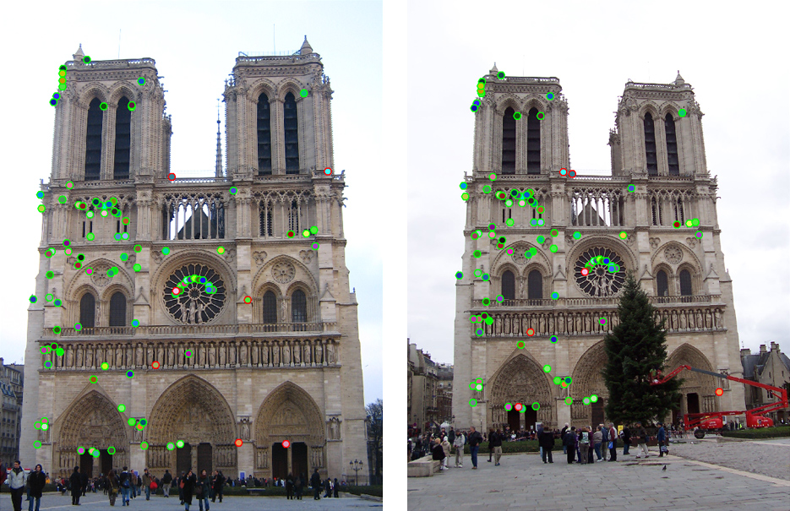
Basic Image Processing and Computer Vision
Feature Extraction and Matching

Slide 22
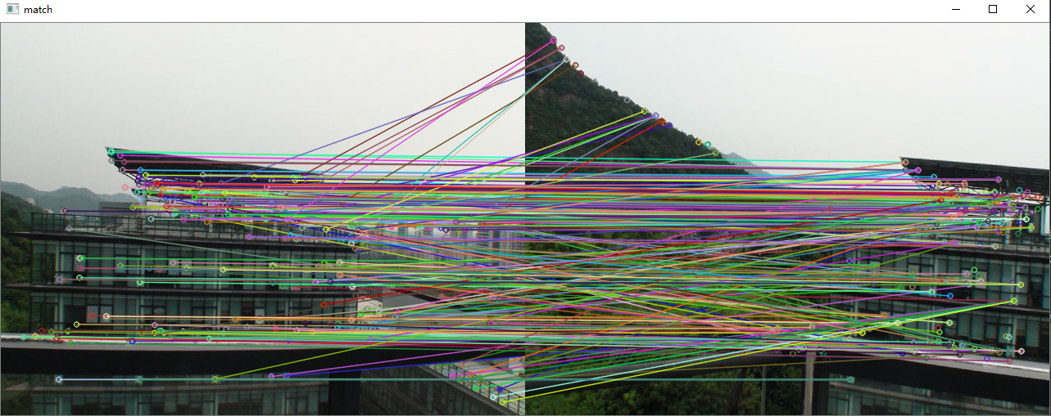
Basic Image Processing and Computer Vision
Feature Extraction and Matching

Slide 23
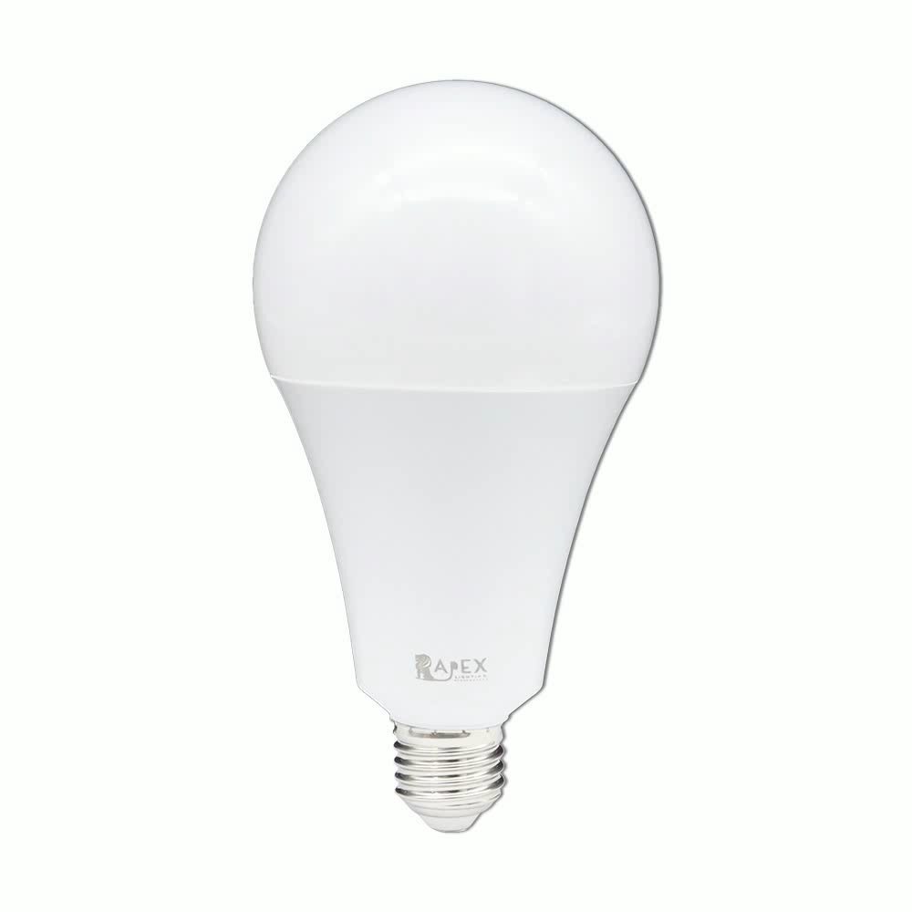
Homework
Homework 1: Active Contour

Slide 24
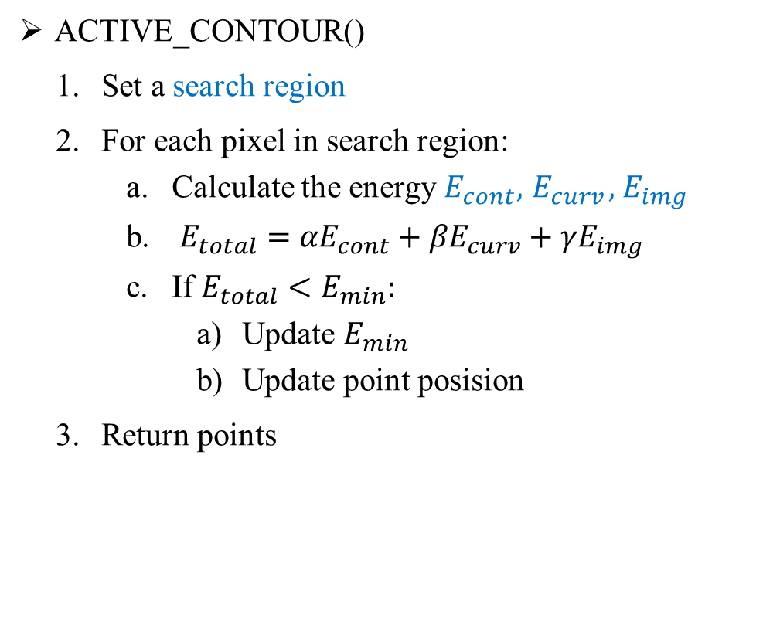
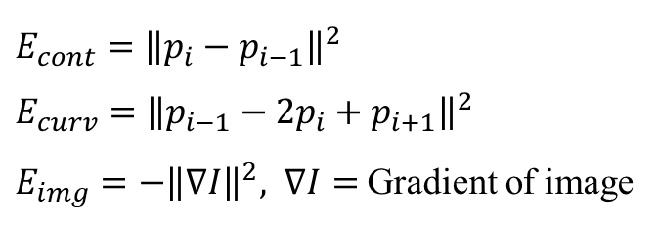
Homework
Read the image
Convert the image to Grayscale
Denoising (Use Gaussian blur)
Calculate the gradient by using Sobel
Generate NUM_POINTS points around the object
For i = 0 to MAX_ITERATION:
points = ACTIVE_CONTOUR()
Stop if no change
Draw new points
ACTIVE_CONTOUR()
Set a search region
For each pixel in search region:
Calculate the energy $E_{cont}, { E}_{curv}, { E}_{img}$
$E_{total}={αE}_{cont}+{βE}_{curv}+{γE}_{img}$
If $E_{total}<E_{min}:$
Update $E_{min}$
Update point posision
Return points
$$E_{cont}={\left\|p_{i}−p_{i−1}\right\|}^{2}$$
$$E_{curv}={\left\|p_{i−1}−2p_{i}+p_{i+1}\right\|}^{2}$$
$E_{img}=−{\left\|∇I\right\|}^{2}, ∇I=$Gradient of image

Slide 25
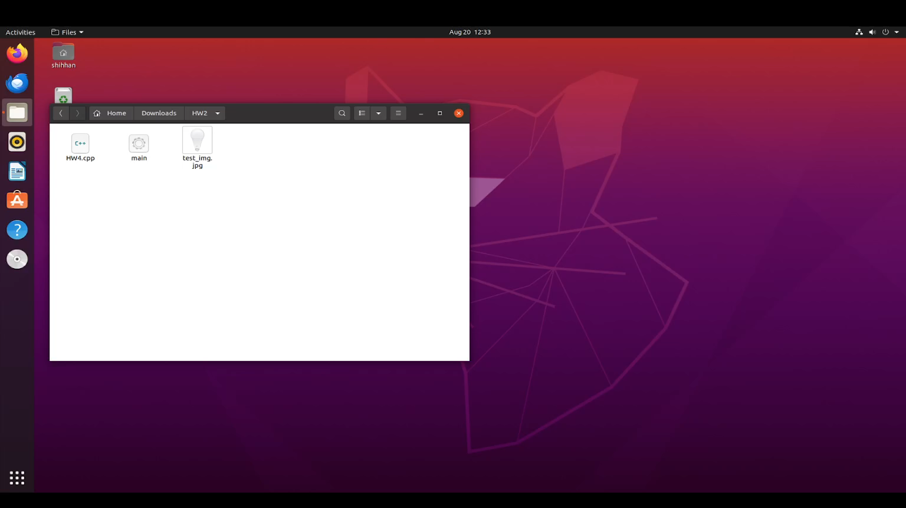
Homework
Homework 1: Active Contour

Slide 26
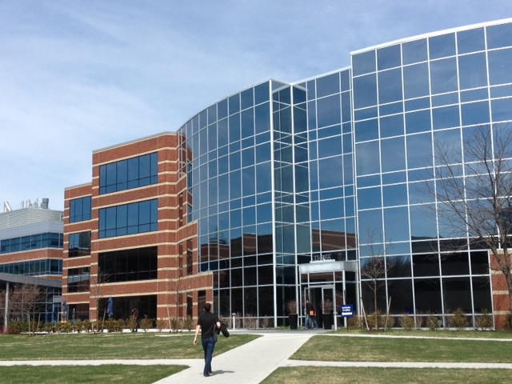
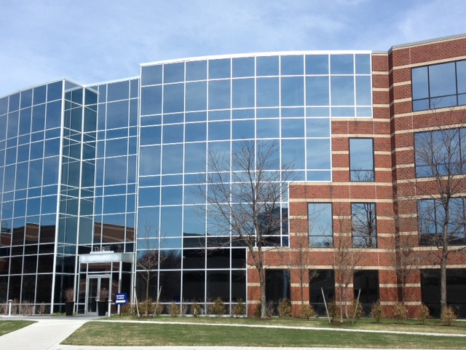
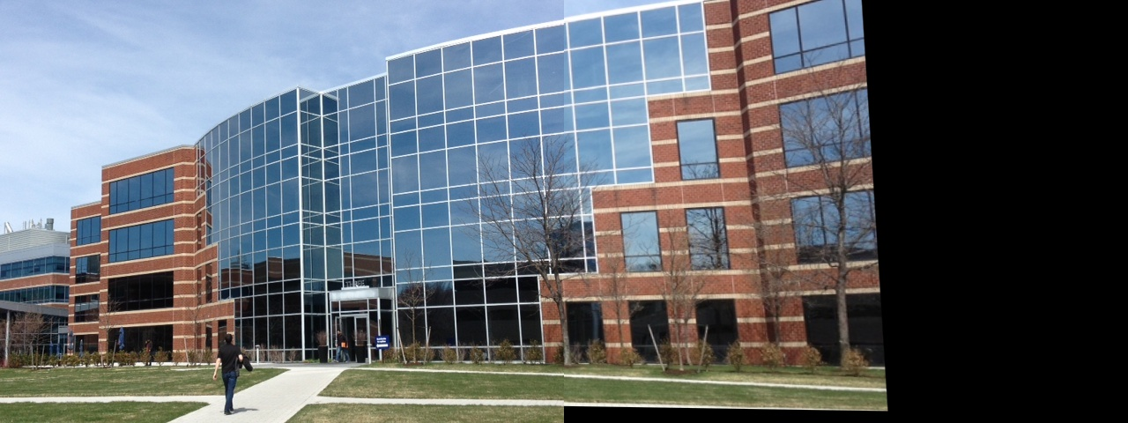
Homework
Homework 2: Image Stitching

Slide 27
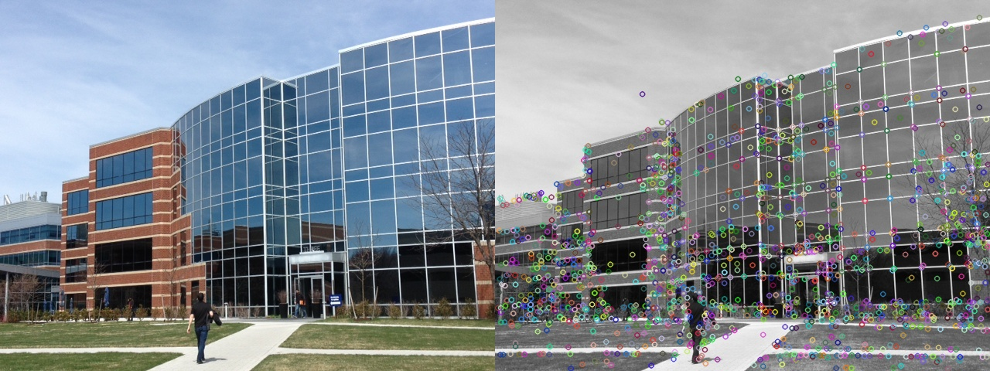
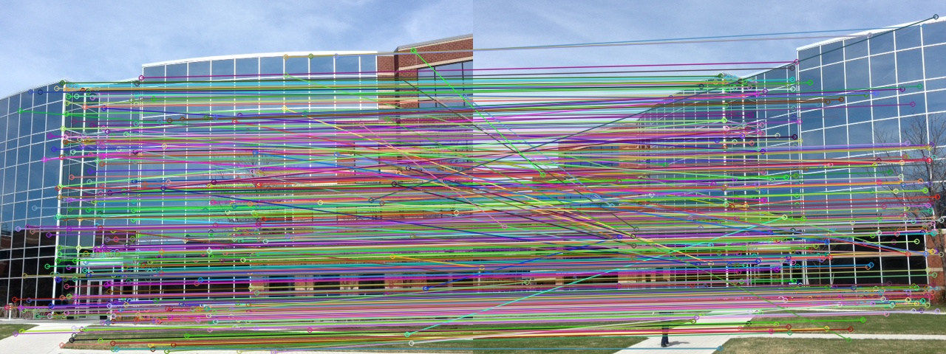
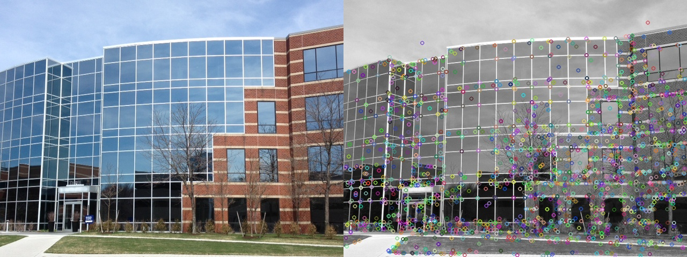
Homework
Homework 2: Image Stitching
Feature Left
Feature Matching
Feature Right
Result

Slide 28
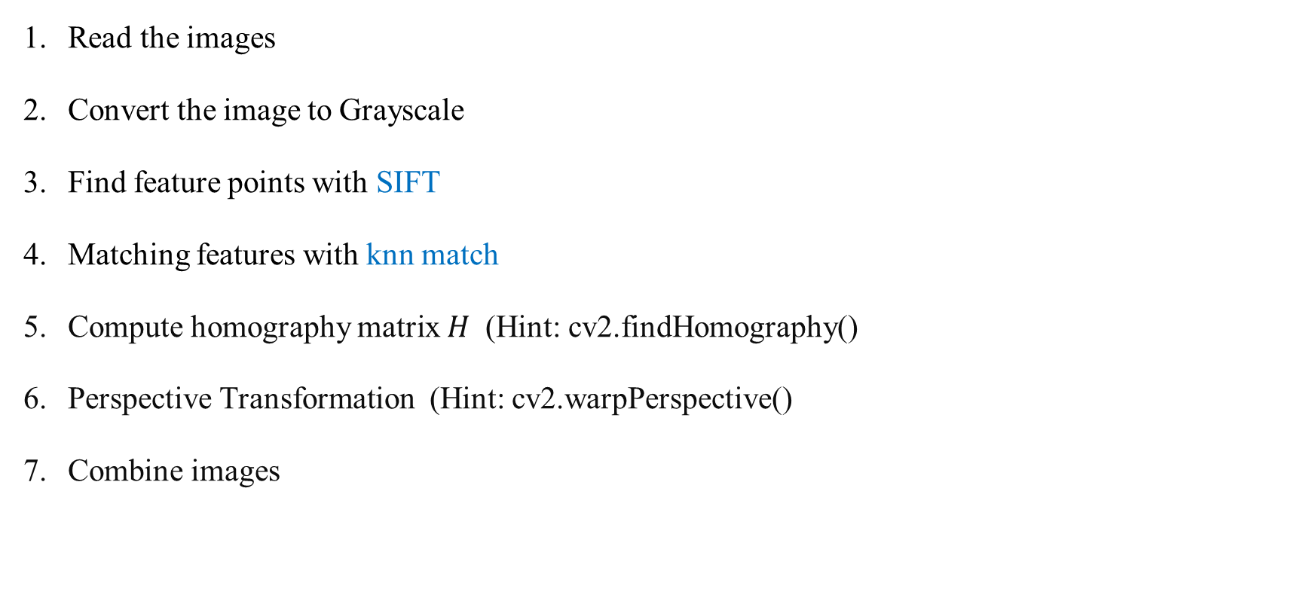
Homework
Read the images
Convert the image to Grayscale
Find feature points with SIFT
Matching features with knn match
Compute homography matrix $H$ (Hint: cv2.findHomography()
Perspective Transformation (Hint: cv2.warpPerspective()
Combine images

Slide 29
Homework
Submission Format
homework/
├─ hw1/
│ ├─ hw1.cpp
│ └─ hw1.mp4
└─ hw2/
│ ├ hw2.py
│ ├ left_feature.jpg
│ ├ right_feature.jpg
│ ├ feature_matching.jpg
│ └ result.jpg
Deadline: 9/1

